Slide 1
Number of Visitors to Surrounding National Parks in 2020
Kacie Rae Cox

Slide 2
Explanation
During this past year, COVID-19 hit and many of the surrounding National Parks had to close down. I was curious how park visitation was affected. For this project, I chose Bryce Canyon National Park, Grand Canyon National Park, and Zion National Park. I researched each park’s data through the government’s website and found data to compare visitation for every month in the past year, as well as compare those monthly averages to previous years.

Slide 3
Explanation Continued
Although I did not include all of the data from the previous years, the information I found was very inclusive and it showed a similar trend to previous years. It was very noticeable when the national parks shut down, however, the increase shortly thereafter was also very prominent. It was very interesting to note how the total number of visitors did not actually decrease and may have even increased from previous years.

Slide 4
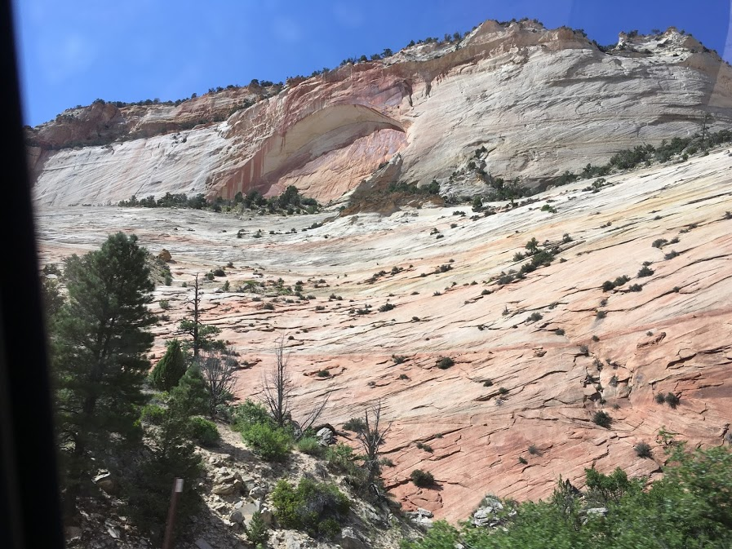
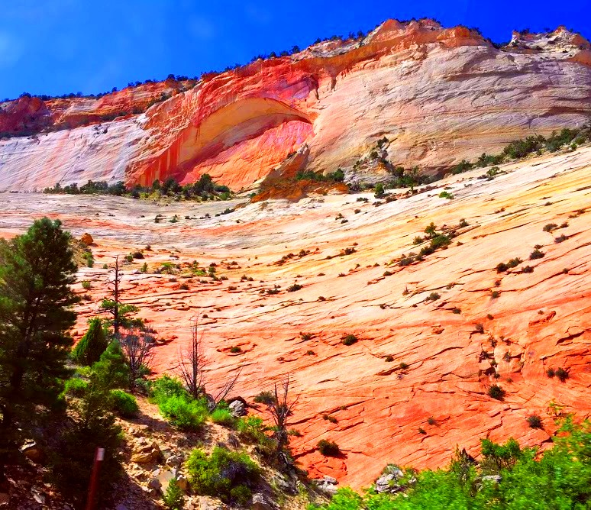
Photo Editing
Editing Software: Pixlr.com
Changes
Cropped Image
Increased Color Vibrance, Saturation, Temperature
Decreased color Tint
Increased Light Contrast
--This picture was taken by my sister.

Slide 5
Thoughts and Reflections (Community Engagement)
This community engagement project is a really fun way to implement the skills we learn and apply it to a practical real-life situation. As a student, I am able to take the knowledge I have gathered for the project and visually represent it.
This is a great project because it is allowing an opportunity to experience a real-job situation that may arise and be able to complete it with ease.

Slide 6
Thoughts and Reflections (Skills)
This project did help me see how to use interconnecting skills between Word, PowerPoint, and Excel. Some of these skills are importing Excel created charts into Word and PowerPoint and learning the many basic features that are possible in each program.
I believe this is really valuable because in any future job, these skills will be valuable and may be used in some form or another. It is important to be able to depict data of any kind in functional, visual, and organized ways.

